Slide 1

YSC2239 Lecture 19-20

Slide 2
Today’s class
Logistic regression – Part 1

Slide 3
Regression vs. Classification

Slide 4
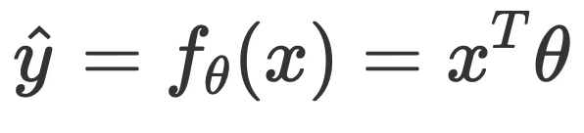
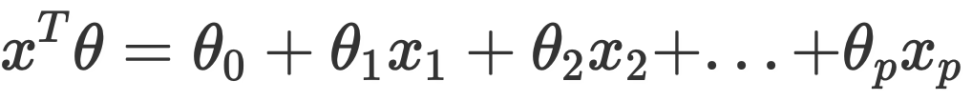
Linear Regression
In a linear regression model, our goal is to predict a quantitative variable (i.e., some real number) from a set of features.
Our output, or response, y, could be any real number.
We determined optimal model parameters by minimizing some average loss, and (sometimes) an added regularization penalty.
Remember, .

Slide 5
Classification
When performing classification, we are instead interested in predicting some categorical variable.
spam or ham
win or lose
disease or no disease

Slide 6
Classification
Binary classification: two classes.
Examples: spam / not spam.
Our responses are either 0 or 1.
Our focus today.
Multiclass classification: many classes.
Examples: Image labeling (cat, dog, car), next word in a sentence, etc.
This is not the first time you are seeing classification!
k-Nearest Neighbors was a classification technique we have learned earlier.

Slide 7
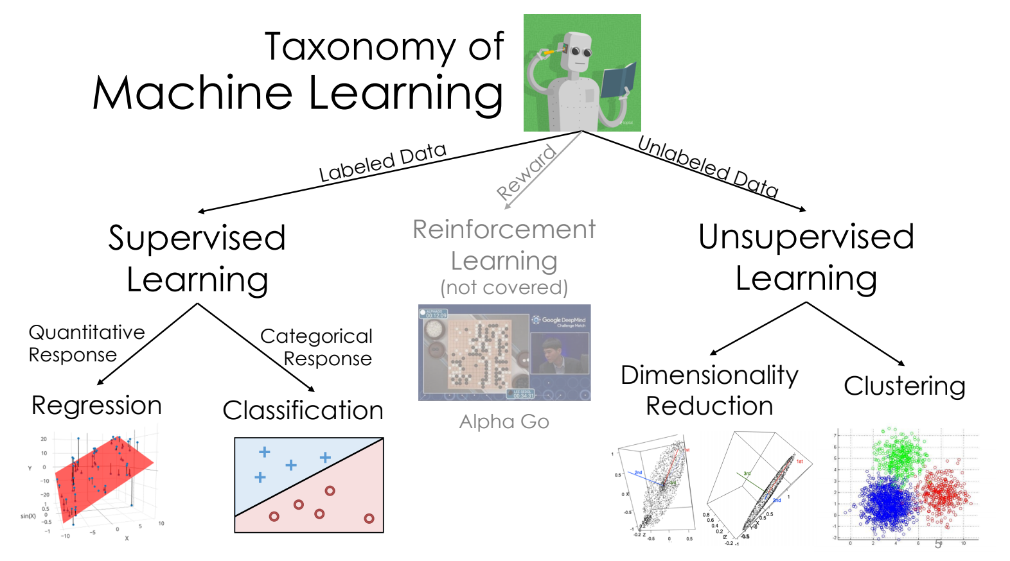
Machine learning taxonomy
Regression and Classification are both forms of supervised learning.
Logistic regression, the topic of this lecture, is mostly used for classification, even though it has “regression” in the name.
from Joseph Gonzalez

Slide 8
Deriving the logistic regression model
In this section, we will mostly work out of the lecture notebook.

Slide 9
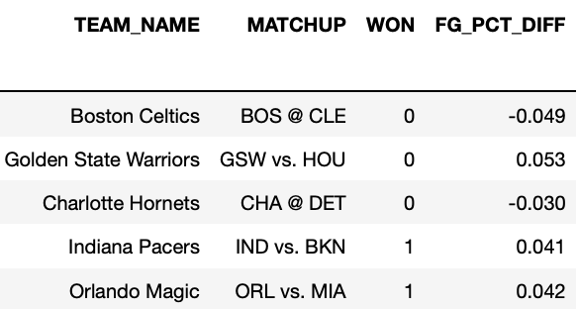
Example dataset
In this lecture, we will primarily use data from the 2017-18 NBA season.
Goal: Predict whether or not a team will win, given their FG_PCT_DIFF.
This is the difference in field goal percentage between the two teams.
Positive FG_PCT_DIFF: team made more shots than the opposing team.
1s represent wins, 0s represent losses.

Slide 10
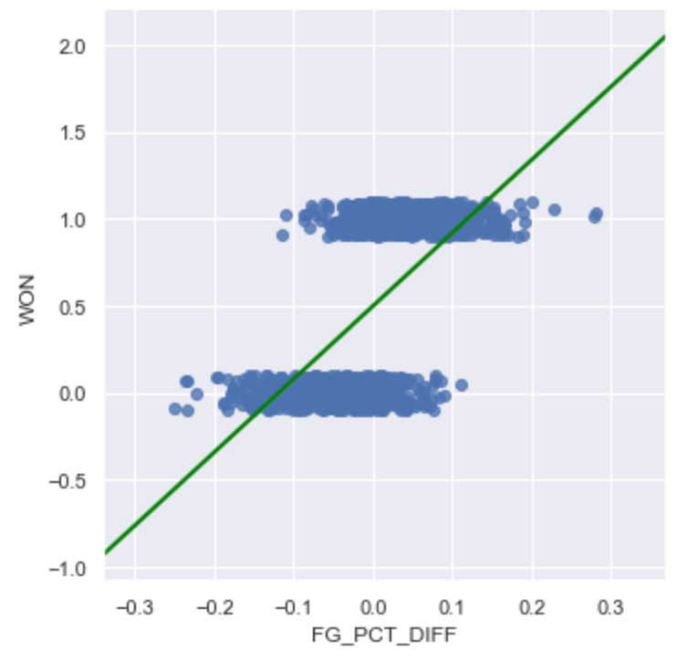
Why not use Ordinary Least Squares?
We already have a model that can predict any quantitative response. Why not use it here?
The output can be outside of the range [0, 1]. What does a predicted WON value of -2 mean?
Very sensitive to outliers.
Many other statistical reasons.
Not the point of our class.

Slide 11
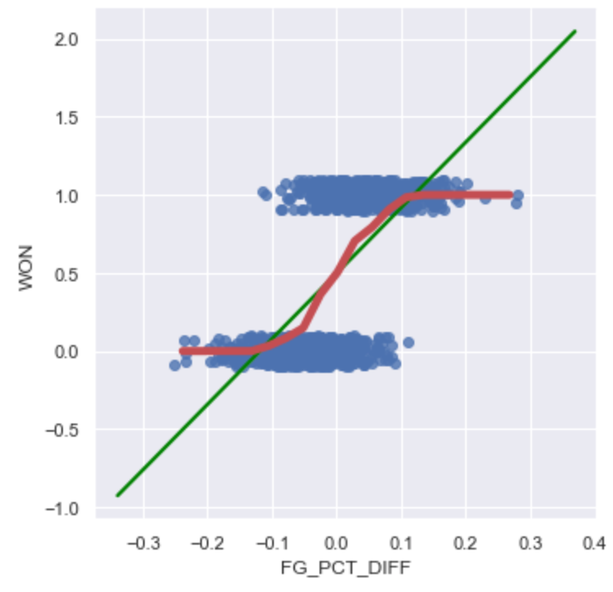
Graph of averages
When defining the simple linear regression model, we binned the x-axis, and took the average y-value for each bin, and tried to model that.
Doing so here yields a curve that resembles an s.
Since our true y is either 0 or 1, this curve models the probability that WON = 1, given FG_PCT_DIFF.
WON = 1 means “belong to class 1”.
Our goal is to model this red curve as best as possible.

Slide 12
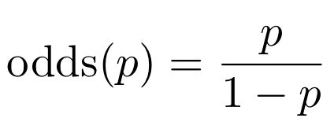
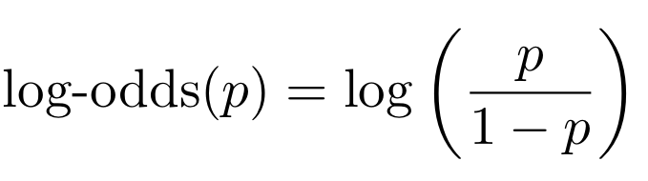
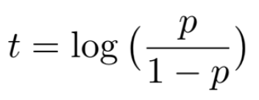
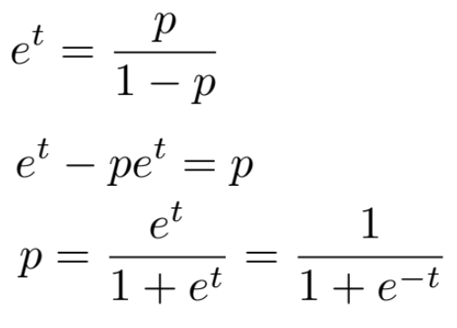
Log-odds of probability is roughly linear
In the demo, we noticed that the log-odds of the probability of belonging to class 1 was linear. This is the assumption that logistic regression is based on.
For now, let’s let t denote our linear function (since log-odds is linear). Solving for p:
With logistic regression, we are always referring to log base e (“ln”).
This is called the logistic function, 𝜎(t).

Slide 13

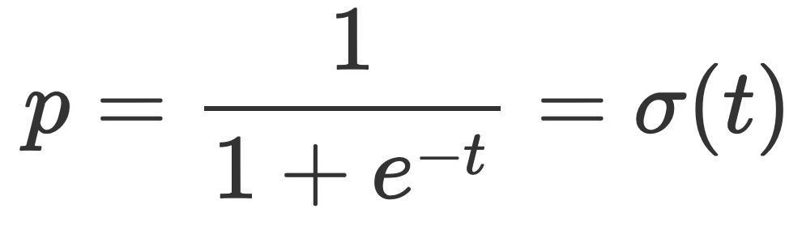
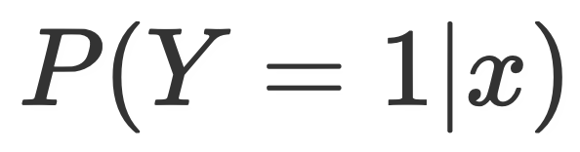
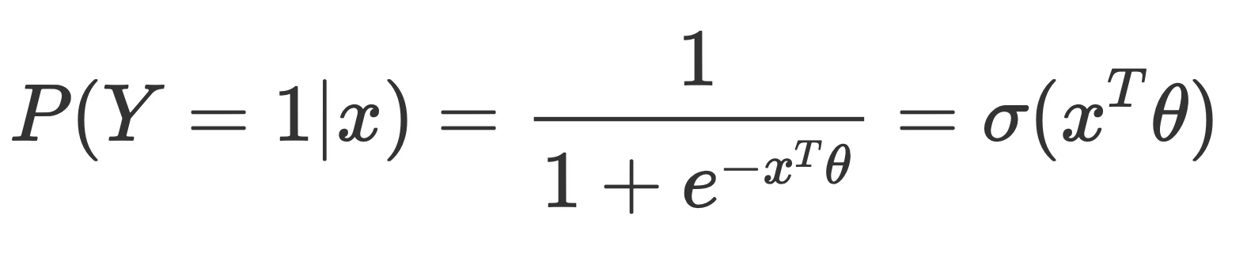
Arriving at the logistic regression model
We know how to model linear functions quite well.
We can substitute , since t was just a placeholder.
p represents the probability of belonging to class 1.
We are modeling .
Putting this all together:
Looks just like the linear regression model, with a 𝞼( ) wrapped around it.
We call logistic regression a generalized linear model, since it is a non-linear transformation of a linear model.

Slide 14
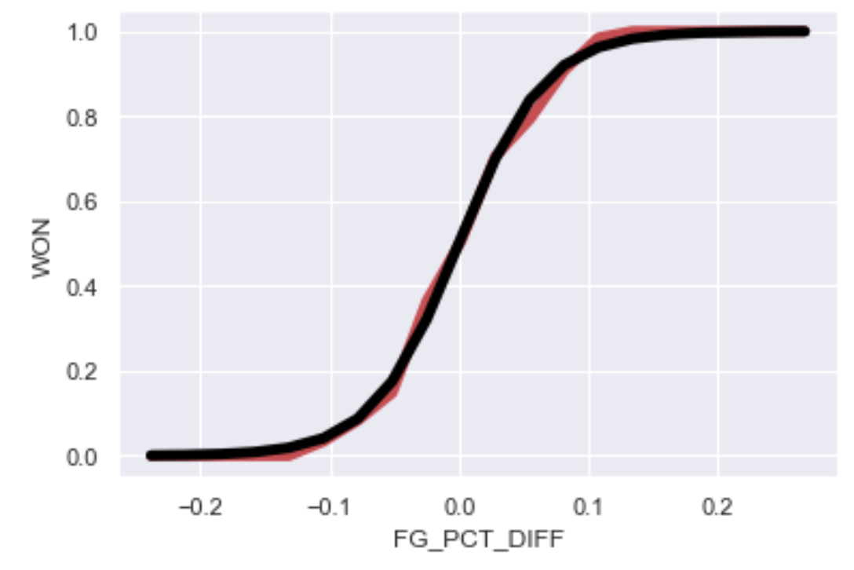
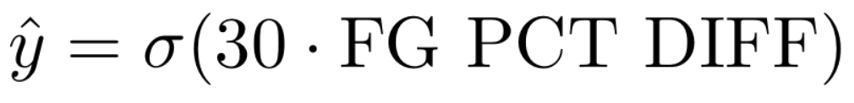
Arriving at the logistic regression model
In red:
Empirical graph of averages
In black:

Slide 15
Logistic regression

Slide 16
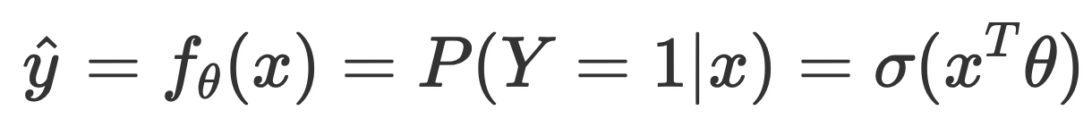
Linear vs. logistic regression
In a linear regression model, we predict a quantitative variable (i.e., some real number) as a linear function of features.
Our output, or response, y, could be any real number.
In a logistic regression model, our goal is to predict a binary categorical variable (class 0 or class 1) as a linear function of features, passed through the logistic function.
Our response is the probability that our observation belongs to class 1.
Haven’t yet done classification!

Slide 17
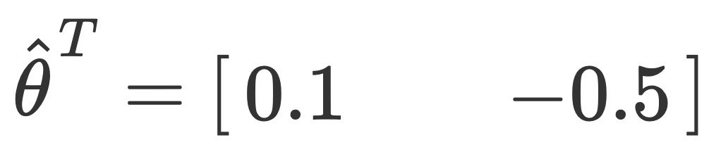

Example calculation
Suppose I want to predict the probability that LeBron’s shot goes in, given shot distance (first feature) and # of seconds left on the shot clock (second feature).
I fit a logistic regression model using my training data, and somehow compute
Under the logistic model, compute the probability his shot goes in, given that
He shoots it from 15 feet.
There is 1 second left on the shot clock.

Slide 18
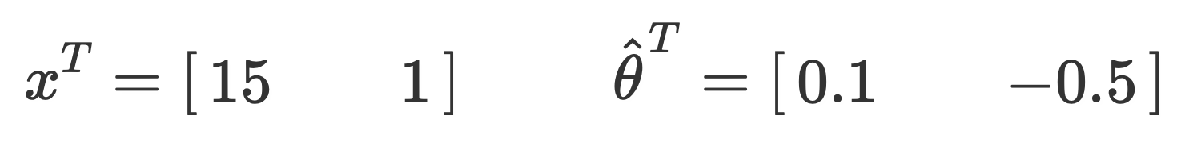
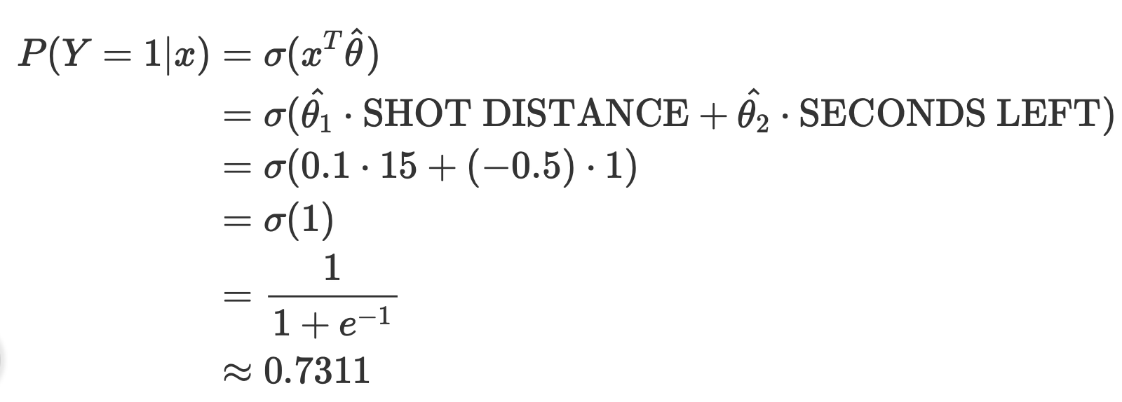
Example calculation (solution)
An explicit expression representing our model.

Slide 19
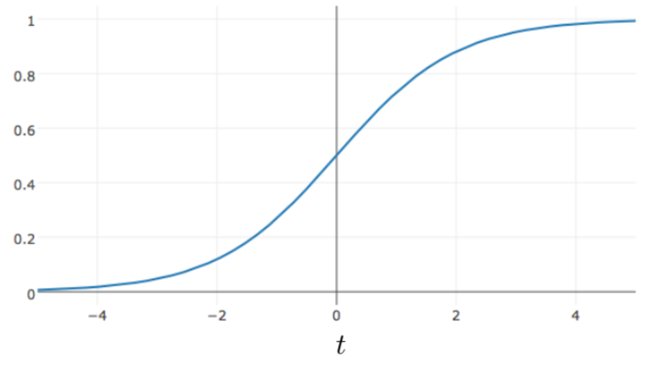
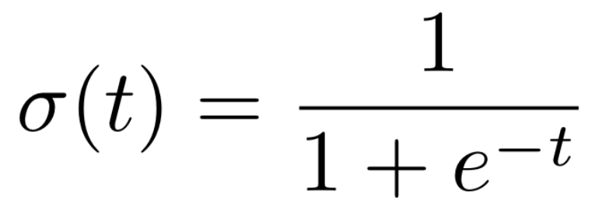

Properties of the logistic function
The logistic function is a type of sigmoid, a class of functions that share certain properties.
Its output is bounded between 0 and 1, no matter how large t is.
Fixes an issue with using linear regression to predict probabilities.
We can interpret it as mapping real numbers to probabilities.

Slide 20
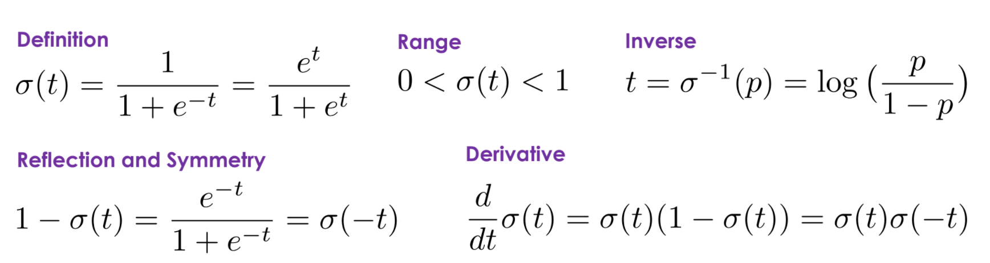
Properties of the logistic function

Slide 21
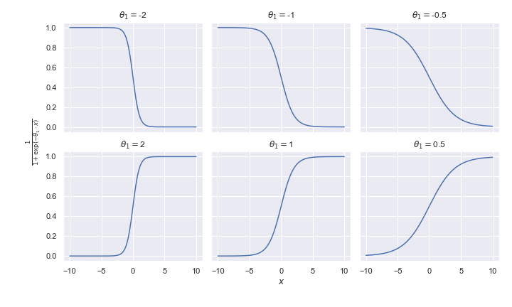
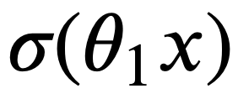
Shape of the logistic function
Consider the plot of , for several different values of 𝜃1.
If 𝜃1 is positive, the curve increases to the right.
The further 𝜃1 is from 0, the steeper the curve.
In the notebook, we explore more sophisticated logistic curves.

Slide 22
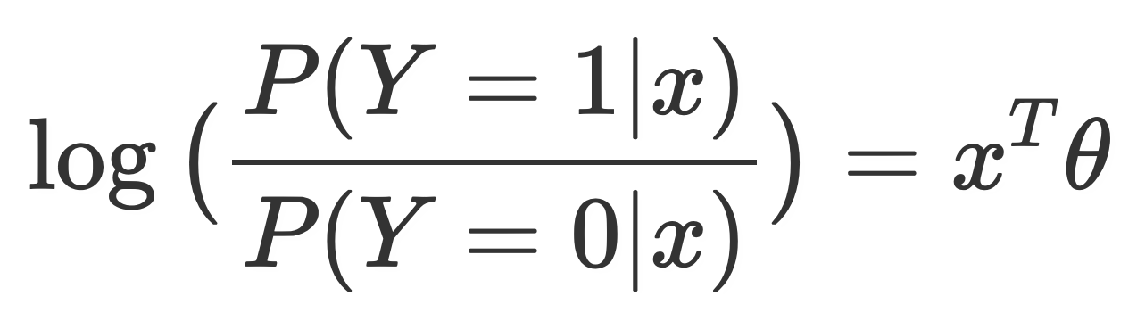
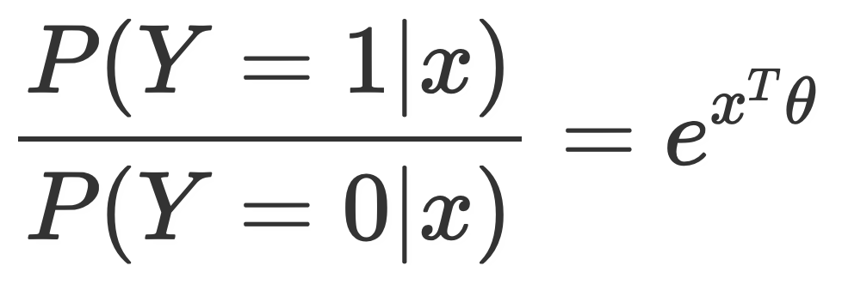
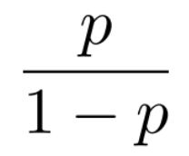
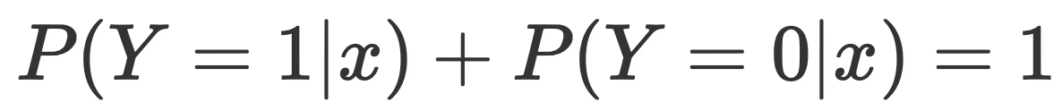
Parameter interpretation
Recall, we arrived at the model by assuming that the log-odds of the probability of belonging to class 1 was linear.
This is the same as , because
(Remember, we are dealing with binary classification – we are predicting 1 or 0.)

Slide 23
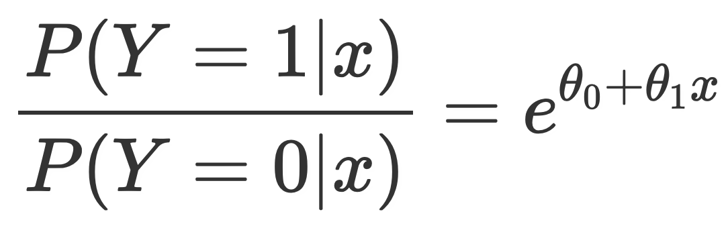
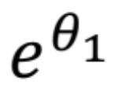
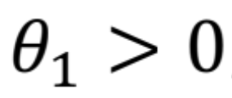
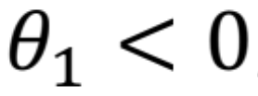
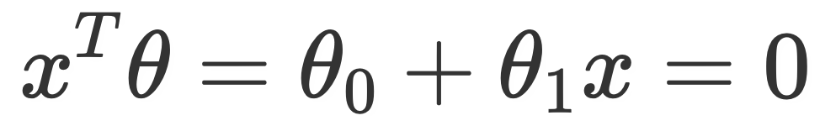
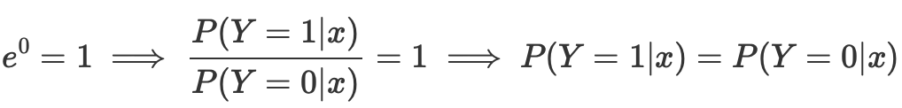
Parameter interpretation
Let’s suppose our linear component has just a single feature, along with an intercept term.
What happens if you increase x by one unit?
Odds is multiplied by .
If , the odds increase.
If , the odds decrease.
What happens if ?
This means class 1 and class 0 are equally likely.
.
The odds ratio can be interpreted as the “number of successes for each failure.”

Slide 24
Today’s class
Logistic regression – Part 2

Slide 25
Logistic regression with squared loss

Slide 26

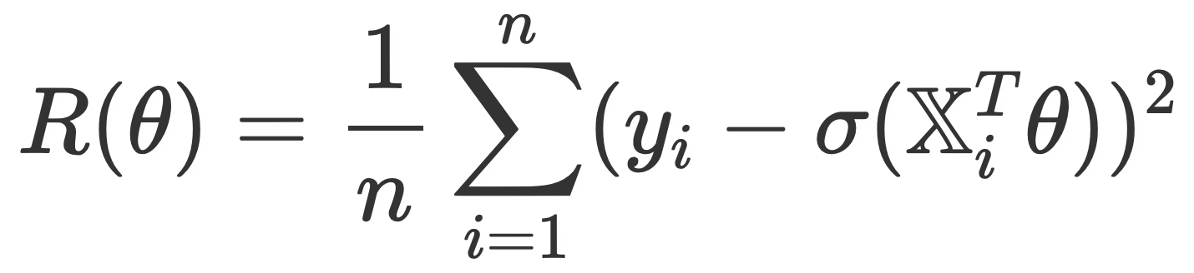
Logistic regression with squared loss
To find so that we can make predictions, we need to choose a loss function.
We can start with our old friend, squared loss.
Doing so yields the following MSE:
Sometimes, this works fine (and it is actually still used in some applications). Other times...

Slide 27
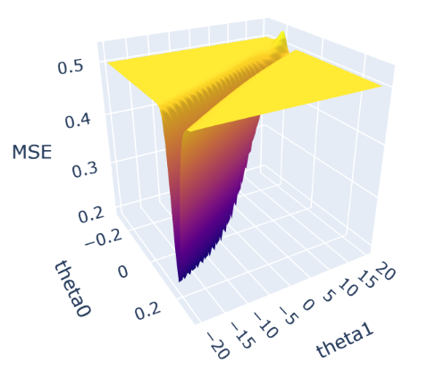
Pitfalls of squared loss with logistic regression
The loss surface of MSE for a logistic regression model with a single slope plus an intercept often looks something like this.

Slide 28

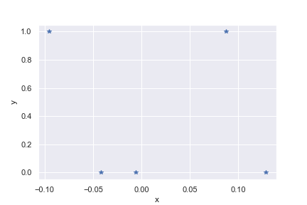
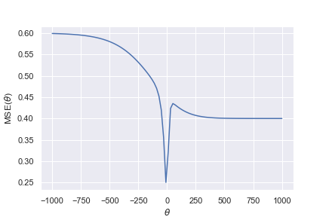
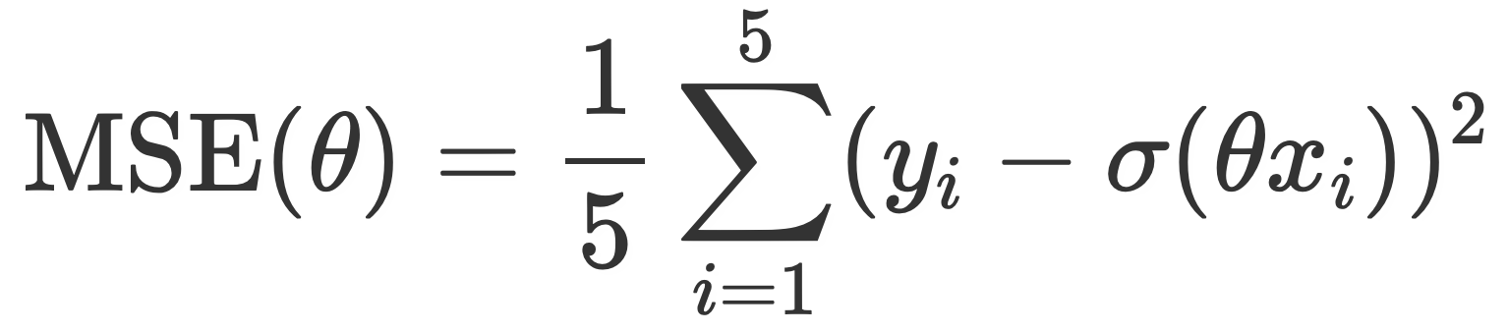
Pitfalls of squared loss with logistic regression
On the left, we have a toy dataset (i.e. we’ve plotted the original data, y vs. x). On the right, we have a plot of the mean squared error of this dataset when fitting a single-feature logistic regression model, for different values of (i.e. the loss surface).

Slide 29
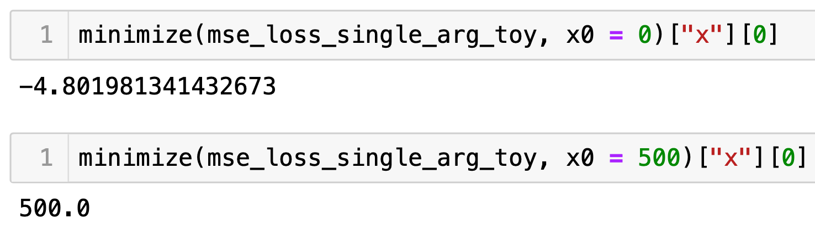
Pitfalls of squared loss with logistic regression
For this particular loss surface, different initial guesses for thetahat yield different “optimal values”, as per scipy.optimize.minimize:
This loss surface is not convex. We’d like it to be convex.

Slide 30
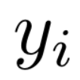
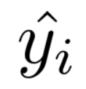
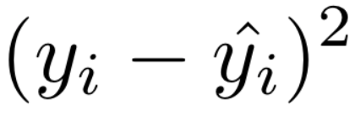
Pitfalls of squared loss with logistic regression
Another issue: since is either 0 or 1, and is between 0 and 1, is also bounded between 0 and 1.
Even if our probability is nowhere close, the loss isn’t that large in magnitude.
If we say the probability is 10^-6, but it happens anyway, error should be large.
We want to penalize wrong answers significantly.

Slide 31
Summary of issues with squared loss and logistic regression
While it can work, squared loss is not the best choice of loss function for logistic regression.
Average squared loss is not nice (non-convex).
Numerical methods will struggle to find a solution.
Wrong predictions aren’t penalized significantly enough.
Squared loss (and hence, average squared loss) are bounded between 0 and 1.
Fortunately, there’s a solution.

Slide 32
Cross-entropy loss

Slide 33
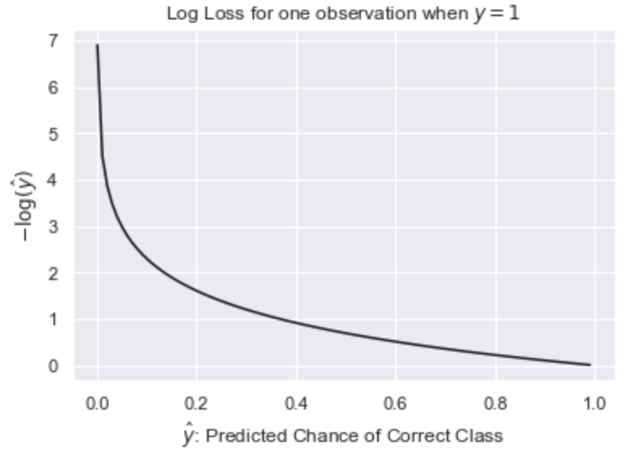
Log loss
Consider this new loss, called the (negative) log loss, for a single observation when the true y is equal to 1.
We can see that as our prediction gets further and further from 1, the loss approaches infinity (unlike squared loss, which maxed out at 1).

Slide 34

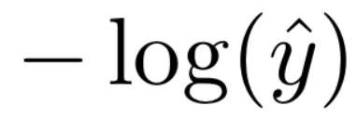
Log loss
Let’s look at some losses in particular:
1 | 0
0.8 | 0.25
0.4 | 1
0.05 | 3
0 | infinity!
Note: The logistic function never outputs 0 or 1 exactly, so there’s never actually 0 loss or infinite loss.

Slide 35
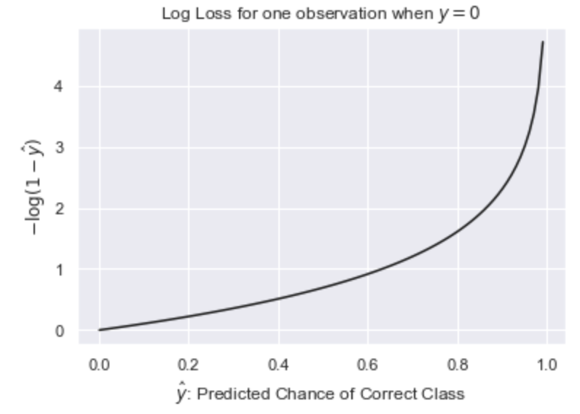
Log loss
So far, we’ve only looked at log loss when the correct class was 1.
What if our correct class is 0?
If the correct class is 0, we want to have low loss for values of close to 0, and high loss for values of close to 1. This is achieved by just “flipping” the plot on the left!

Slide 36
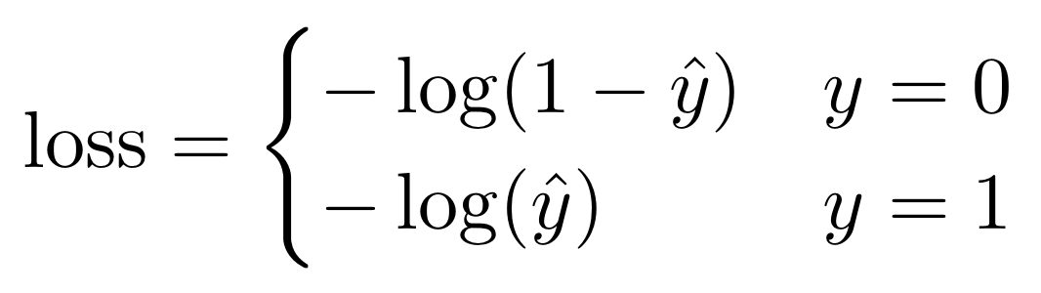
Cross-entropy loss
We can combine the two cases from the previous slide into a single loss function:
This is often written unconditionally as:
Note: Since y = 0 or 1, one of these two terms is always equal to 0, which reduces this equation to the piecewise one above.
We call this loss function cross-entropy loss (or “log loss”).

Slide 37
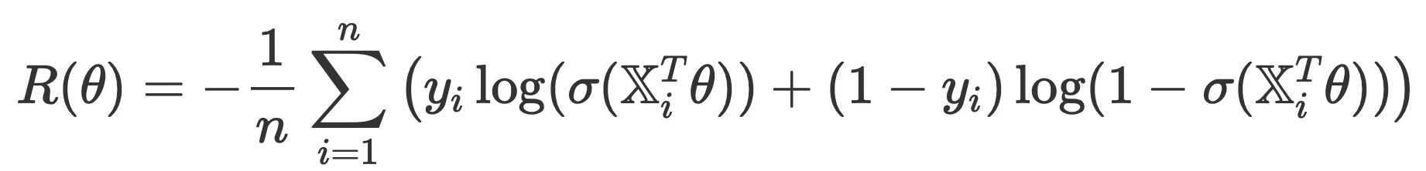
Mean cross-entropy loss
The empirical risk for the logistic regression model when using cross-entropy loss is then
Benefits over mean squared error for logistic regression:
Loss surface is guaranteed to be nice (convex).
More strongly penalizes bad predictions.
Has roots in probability and information theory

Slide 38
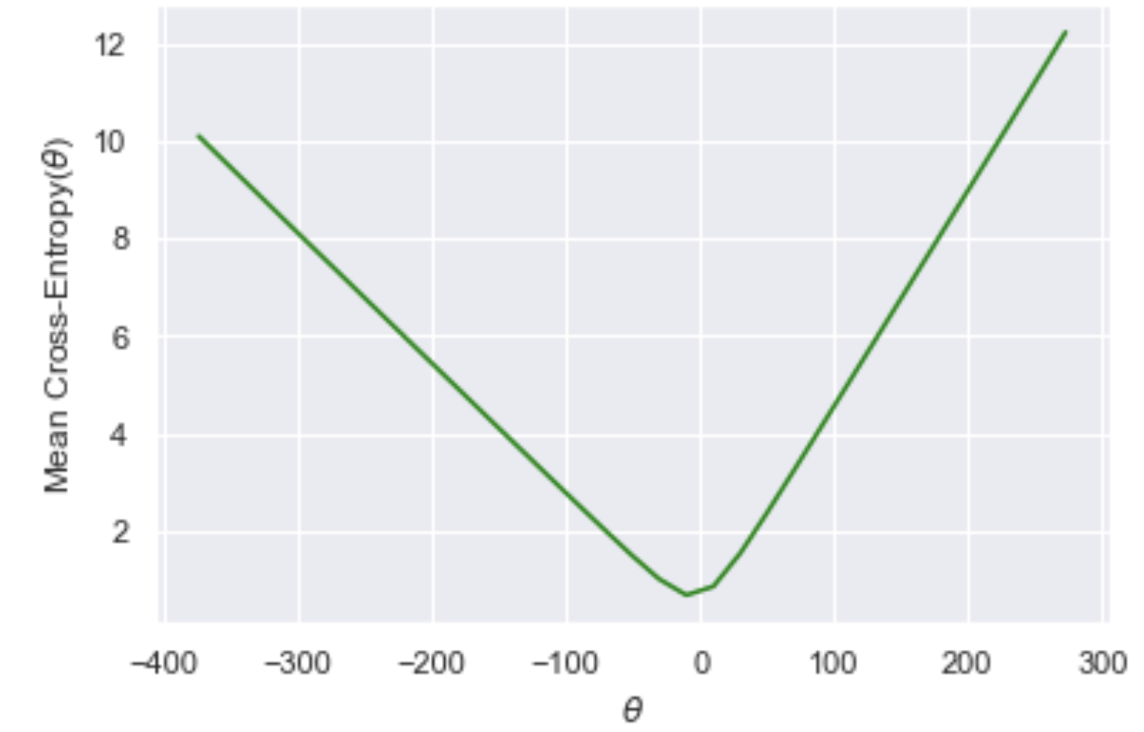
Comparing loss surfaces
On the left, we have a plot of the MSE loss surface on our toy dataset from before. On the right, we have a plot of the mean cross-entropy loss surface on the same dataset.

Slide 39
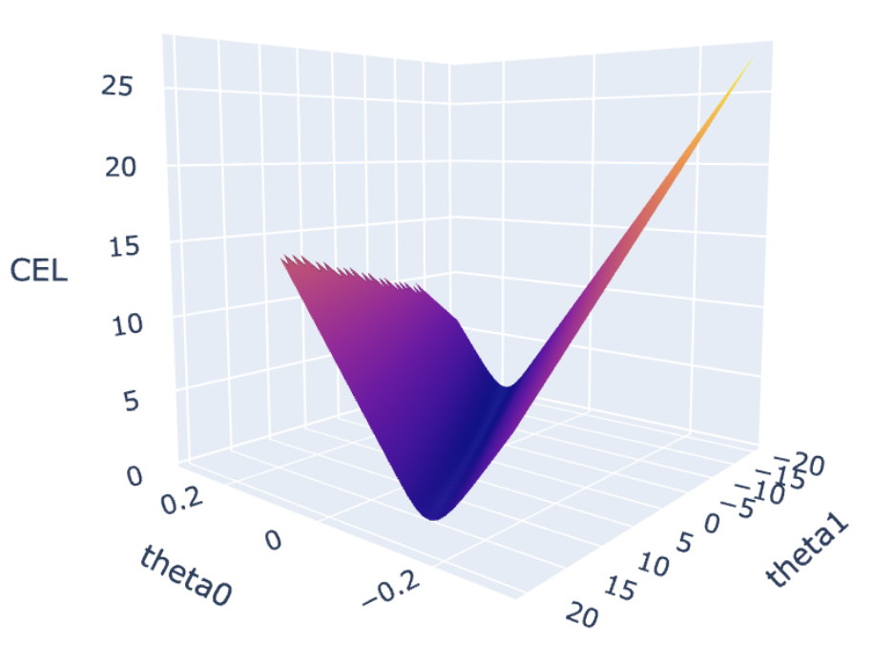
Comparing loss surfaces
We might get stuck in this “plateau”.
We will always end up in this “valley”.

Slide 40
Summary

Slide 41
Logistic regression
In a logistic regression model, our goal is to predict a binary categorical variable (class 0 or class 1) as a linear function of features, passed through the logistic function.
Our response is the probability that our observation belongs to class 1.
We arrived at this model by assuming that the log-odds of the probability of belonging to class 1 is linear.
To find , we can choose squared loss or cross-entropy loss.
Squared loss works, but is generally not a good idea.
Cross-entropy loss is much better (convex, better suited for modeling probabilities).

